Slide 1
Global 3D Camera
A glimpse of now and next
Ding
2024/Q2

Slide 2
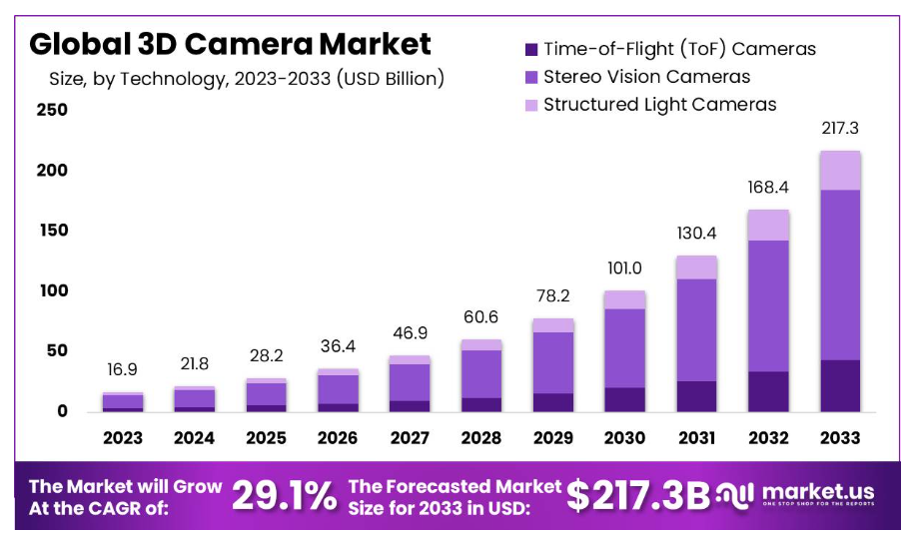
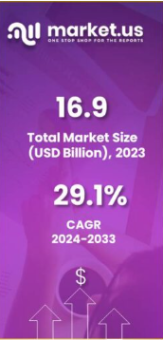
3D Camera Market Growth Overview
CART 14.08%
https://market.us/report/3d-camera-market/
3D cameras are designed to capture images and videos in three dimensions, providing depth perception for a more immersive visual experience.

Slide 3
3D Camera Market Growth Overview
3D cameras are designed to capture images and videos in three dimensions, providing depth perception for a more immersive visual experience.
https://market.us/report/3d-camera-market/
1
The 3D Camera market is expected to grow by 29.1% from 2024 until 2033.
2
The market’s value for 2023 stood at USD 16.9 billion and is projected to be USD 217.3 billion in 2033.

Slide 4
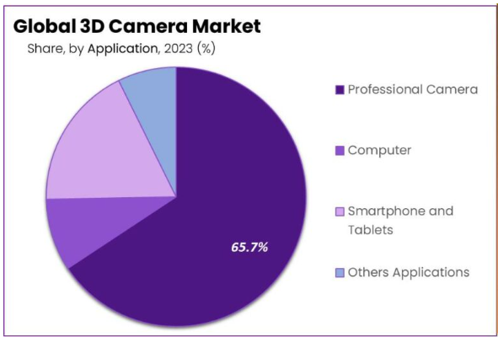
3D Camera Driving Factors 2023
0
2023 Status Quo
Applications of 3D Cameras:
Major applications include 3D modeling and design, augmented/virtual reality experiences, post-production VFX, and facial recognition.
Regional Dynamics:
Asia Pacific emerged as the dominant player, capturing over 38.2% of the market share, driven by a robust manufacturing ecosystem and the adoption of 3D imaging technologies.
Key Market Players:
Major players in the 3D camera market include Sony Corporation, Fujifilm Holdings Corporation, Panasonic Corporation, Canon Inc., Nikon Corporation, GoPro, Inc., and Samsung Electronics Co., Ltd.
Consumer Demand for Enhanced Imaging:
The increasing demand for high-quality 3D imaging in smartphones, tablets, and digital cameras is a major driving force.
Consumers seek immersive experiences and innovative photography capabilities, spurring manufacturers to integrate 3D cameras into their devices.
Growth of AR and VR:
The proliferation of AR and VR applications across diverse industries, including gaming, healthcare, and education, is driving the uptake of 3D cameras.
These cameras play a crucial role in crafting lifelike and interactive virtual environments, ultimately elevating user experiences.
Industrial Automation and Robotics:
In industrial sectors, the need for automation, quality control, and precise object recognition is driving the demand for 3D cameras.
They play a vital role in applications like robotic assembly lines, ensuring efficiency and accuracy.
Advancements in Automotive Safety:
Advanced Driver Assistance Systems (ADAS) and autonomous vehicles depend on 3D cameras for functions such as depth perception, object detection, and collision avoidance.
The increasing focus on vehicle safety and advancements in self-driving technology is driving the widespread adoption of 3D cameras in the automotive industry.
1
Challenges:
Challenges in calibration and accuracy, data processing complexity, interoperability, and ethical considerations are factors that need to be addressed in the 3D camera market.
2
Future Trends:
Depth sensing for photography and LiDAR integration are prominent trends in the 3D camera market.

Slide 5
3D Camera Driving Factors(2023)
Consumer Demand for Enhanced Imaging:
The increasing demand for high-quality 3D imaging in smartphones, tablets, and digital cameras is a major driving force.
Consumers seek immersive experiences and innovative photography capabilities, spurring manufacturers to integrate 3D cameras into their devices.
Growth of AR and VR:
The proliferation of AR and VR applications across diverse industries, including gaming, healthcare, and education, is driving the uptake of 3D cameras.
These cameras play a crucial role in crafting lifelike and interactive virtual environments, ultimately elevating user experiences.
Industrial Automation and Robotics:
In industrial sectors, the need for automation, quality control, and precise object recognition is driving the demand for 3D cameras.
They play a vital role in applications like robotic assembly lines, ensuring efficiency and accuracy.
Advancements in Automotive Safety:
Advanced Driver Assistance Systems (ADAS) and autonomous vehicles depend on 3D cameras for functions such as depth perception, object detection, and collision avoidance.
The increasing focus on vehicle safety and advancements in self-driving technology is driving the widespread adoption of 3D cameras in the automotive industry.
0
2023 Status Quo
Applications of 3D Cameras:
Major applications include 3D modeling and design, augmented/virtual reality experiences, post-production VFX, and facial recognition.
Regional Dynamics:
Asia Pacific emerged as the dominant player, capturing over 38.2% of the market share, driven by a robust manufacturing ecosystem and the adoption of 3D imaging technologies.
Key Market Players:
Major players in the 3D camera market include Sony Corporation, Fujifilm Holdings Corporation, Panasonic Corporation, Canon Inc., Nikon Corporation, GoPro, Inc., and Samsung Electronics Co., Ltd.
1
Challenges
Challenges in calibration and accuracy, data processing complexity, interoperability, and ethical considerations are factors that need to be addressed in the 3D camera market.
2
Future Trends
Depth sensing for photography and LiDAR integration are prominent trends in the 3D camera market.
Notes:
Consumer Demand for Enhanced Imaging:
The increasing demand for high-quality 3D imaging in smartphones, tablets, and digital cameras is a major driving force.
Consumers seek immersive experiences and innovative photography capabilities, spurring manufacturers to integrate 3D cameras into their devices.
Growth of AR and VR:
The proliferation of AR and VR applications across diverse industries, including gaming, healthcare, and education, is driving the uptake of 3D cameras.
These cameras play a crucial role in crafting lifelike and interactive virtual environments, ultimately elevating user experiences.
Industrial Automation and Robotics:
In industrial sectors, the need for automation, quality control, and precise object recognition is driving the demand for 3D cameras.
They play a vital role in applications like robotic assembly lines, ensuring efficiency and accuracy.
Advancements in Automotive Safety:
Advanced Driver Assistance Systems (ADAS) and autonomous vehicles depend on 3D cameras for functions such as depth perception, object detection, and collision avoidance.
The increasing focus on vehicle safety and advancements in self-driving technology is driving the widespread adoption of 3D cameras in the automotive industry.

Slide 6
3D Camera Growth Opportunities
a
Healthcare Imaging
The healthcare sector offers significant growth opportunities for 3D cameras in medical imaging, surgical navigation, and patient monitoring.
The ability to capture precise 3D anatomical data enhances diagnostics and treatment.
Customized 3D Scanning Solutions
Tailoring 3D camera solutions for specific industries, such as manufacturing and architecture, presents opportunities for providers to meet specialized needs and gain a competitive edge.
Miniaturization and Wearable Devices
Advancements in miniaturizing 3D camera technology open doors for wearable devices and applications like AR glasses, where compact and lightweight cameras are essential.
AI Integration:
Integrating artificial intelligence (AI) with 3D cameras for real-time object recognition and analysis enhances their capabilities.
This integration can drive growth in applications like retail analytics and security.
b
c
d
Market Growth and Projections:
The 3D Camera market is expected to grow by 29.1% over the timeframe from 2024 until 2033.
The market’s value for 2023 stood at USD 16.9 billion and s projected to be USD 217.3 billion in 2033.
3D Camera Functionality:
3D cameras are designed to capture images and videos in three dimensions, providing depth perception for a more immersive visual experience.

Slide 7
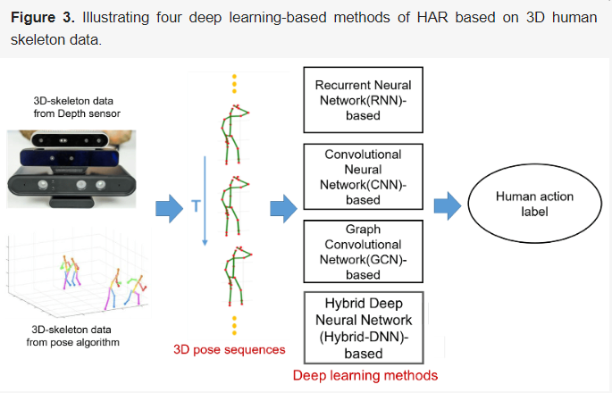
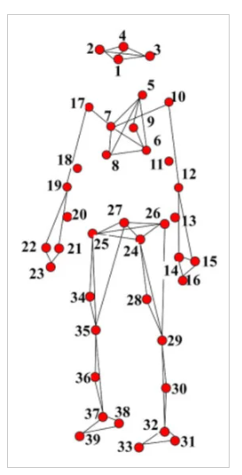
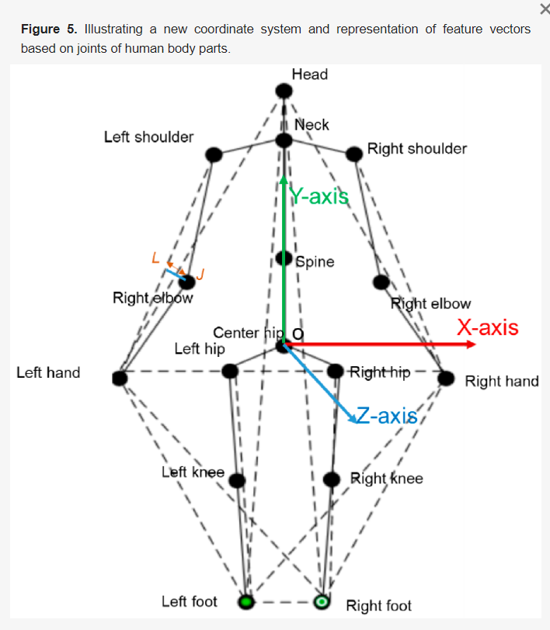
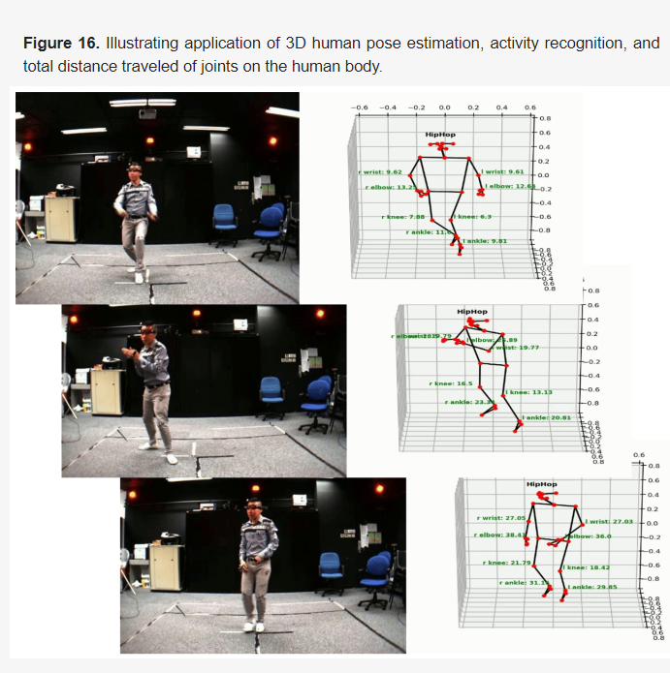
3D Camera Application with Artificial Intelligence (AI)

Slide 8
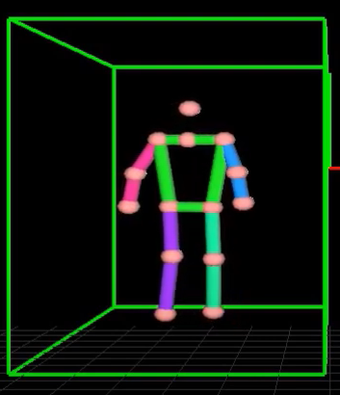
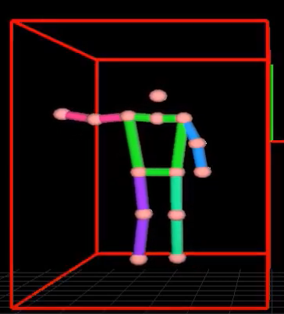
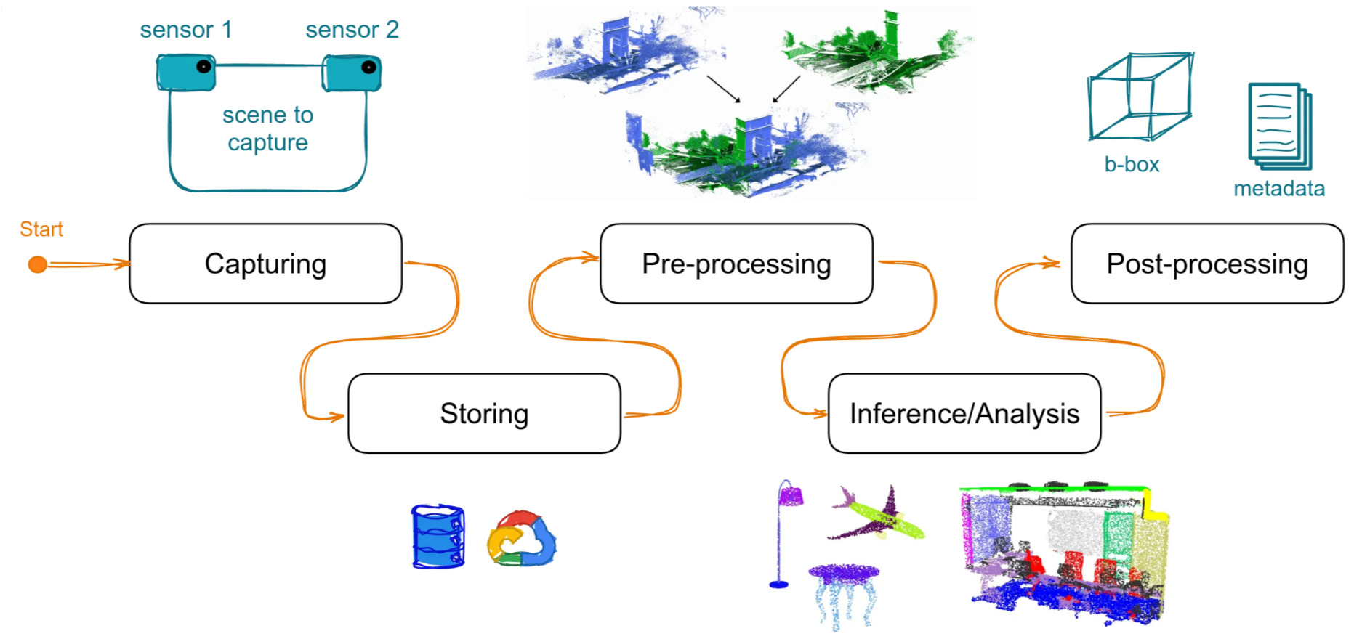
3D Camera Application with Artificial Intelligence (AI)

Slide 9
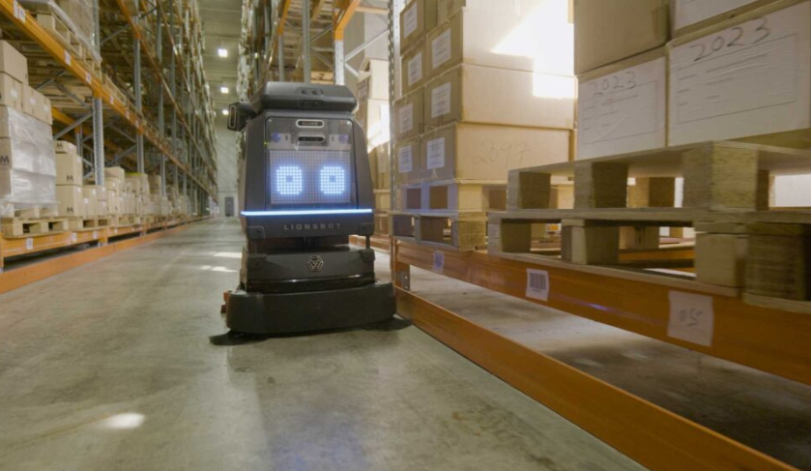
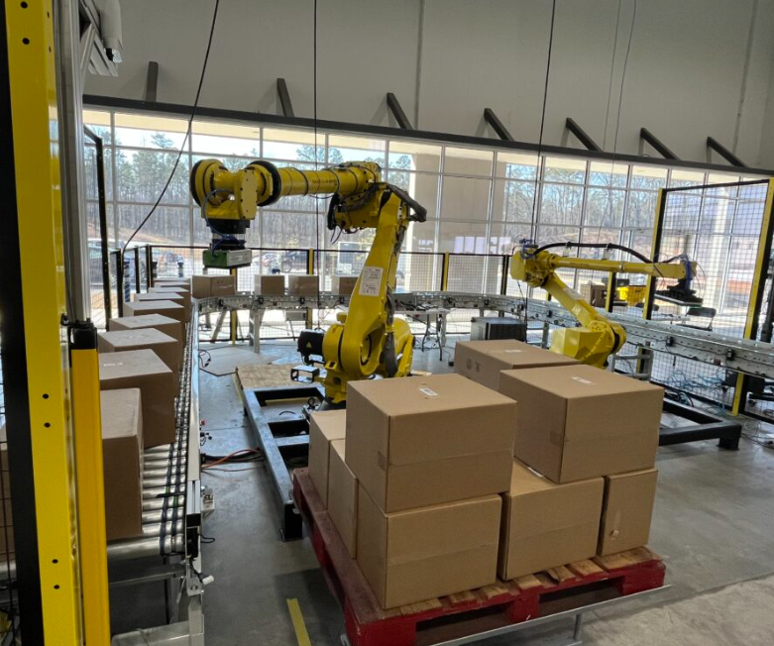
3D Camera Applications
|
Robotics
|
Robotics
工廠自走清潔機器人
Lionsbot
自動撿貨
Pelican Robotics
Solomon
Notes:
The R3 Scrub Pro: Pro Cleaning Made Easy (youtube.com)
Yaskawa Robot Demo at Pelican Systems (youtube.com)
Dual Robot Arm Bin Picking Demo | AccuPick (youtube.com)

Slide 10
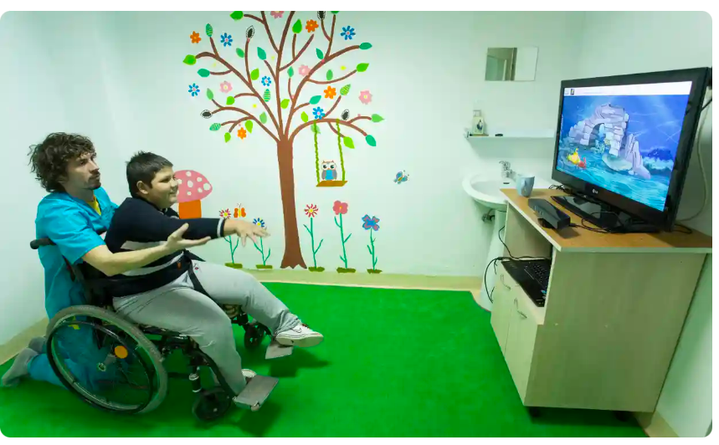
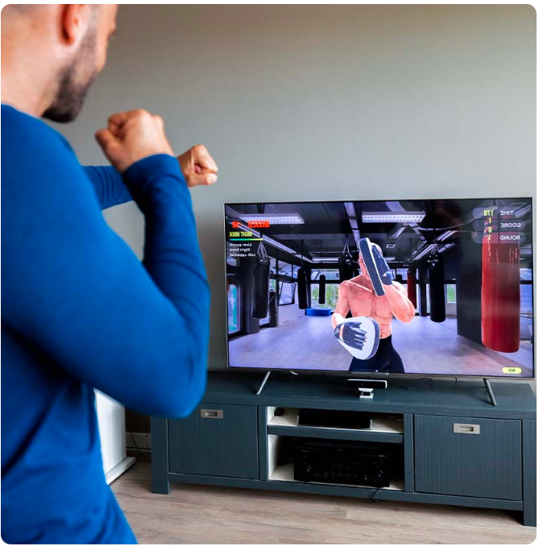
3D Camera Applications
|
Health Tech
|
Fitness
互動復健
MIRA software platform
互動運動/遊戲
Fittar smart box
Notes:
https://www.youtube.com/watch?v=RcGDS6iFXM8
https://www.youtube.com/watch?v=pK-AJ1b6AwM

Slide 11
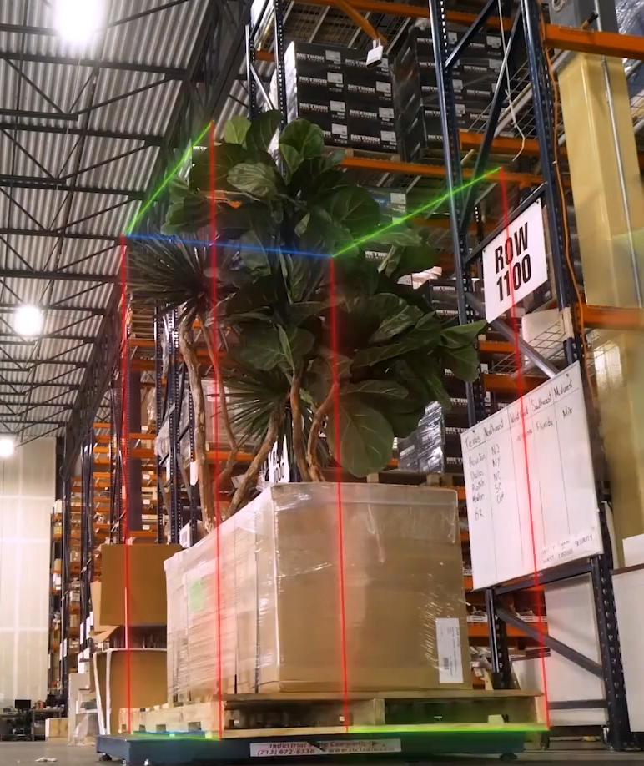
3D Camera Applications
|
Logistic
貨品尺寸自動量測
Cargo Spectre
Notes:
https://www.youtube.com/watch?v=v-OQgIvWjZ4

Slide 12


有其他問題嗎？
Solomon AI and 3D Vision - YouTube

Slide 13
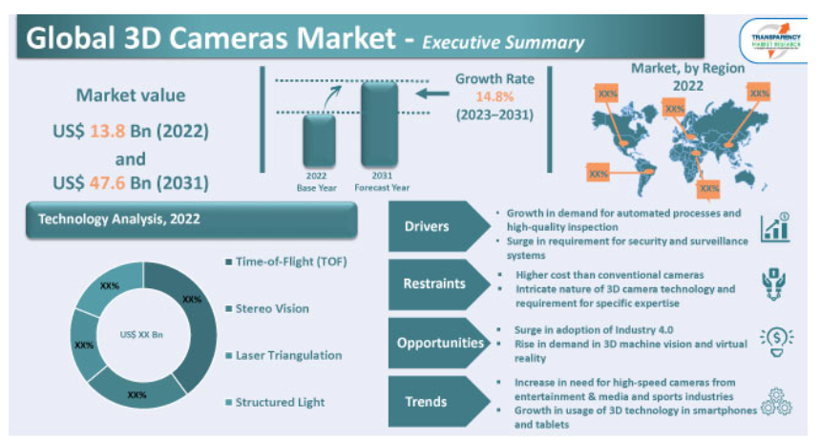
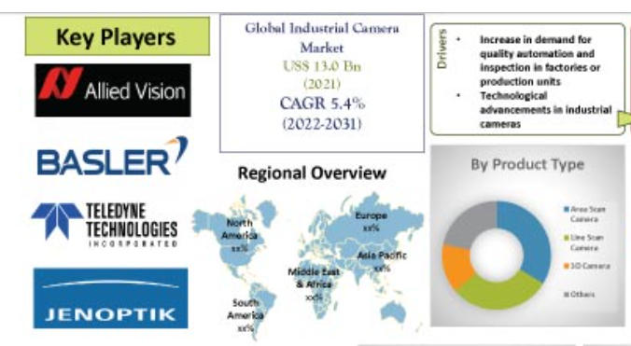
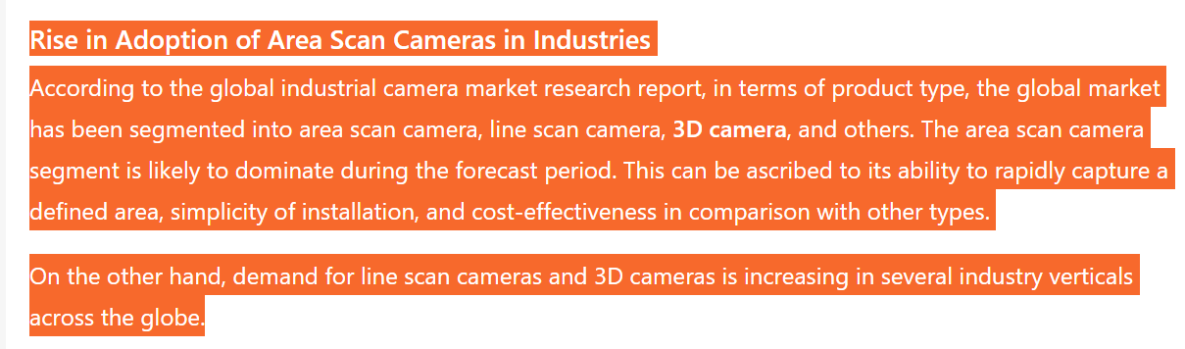
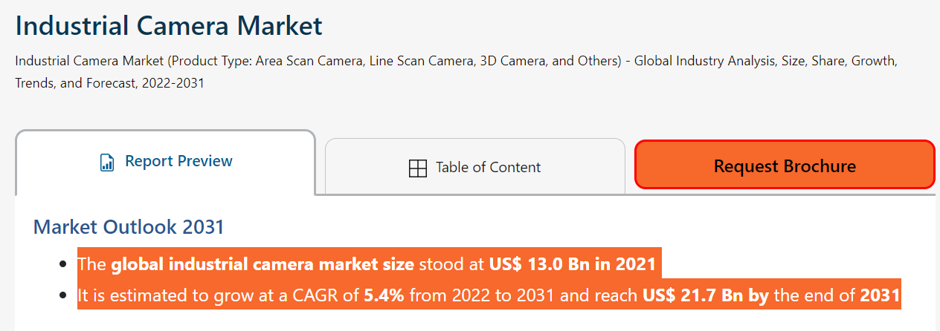
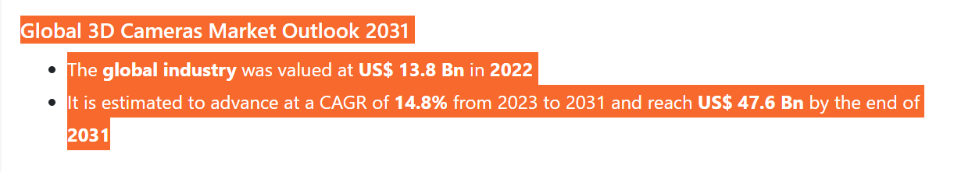
3D Camera Market Growth Overview
https://www.transparencymarketresearch.com/industrial-camera-market.html
https://www.transparencymarketresearch.com/3d-cameras-market.html
The global industry was valued at US$ 13.8 Bn in 2022.
It is estimated to advance at a CART of 14.08% from 2023 to 2031.
The value reaches US$ 47.6 Bn in 2031.

Slide 14
Robotics
 | Fittar Smart Box.
Logistics | 貨品尺寸自動量測 Cargo Spectre
Retail & Consumer

Slide 15
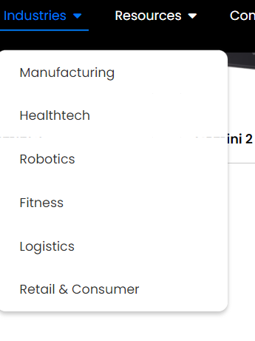
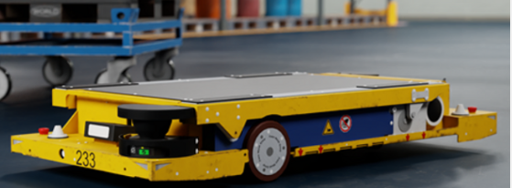
Robotics | 工廠自走清潔機器人 Lionsbot | 自動撿貨 Pelican Robotics https://www.youtube.com/@Solomon_3D/videos
 | 復健 MIRA software platform

Slide 16
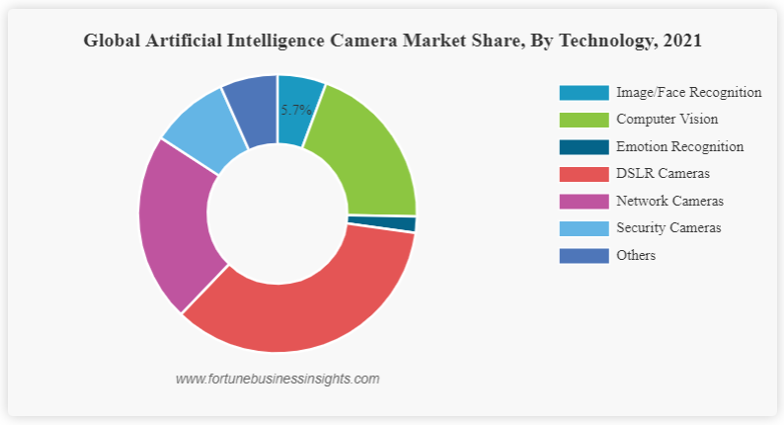

Slide 18
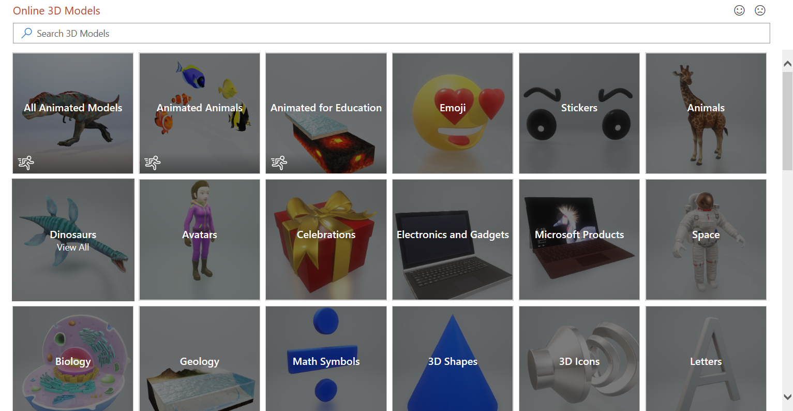
沒有 3D 模型嗎？沒關係！
Microsoft 可讓您輕鬆插入 3D 模型！只要移至 [插入] 功能區，然後按一下 [3D 模型] 選項即可。選擇線上來源圖庫選項 (顯示在右側)。選取您要插入的模型。
3D 模型是訂閱專屬的功能。如果您擁有訂閱，下一張投影片會為您說明它在新簡報中的使用方式。

Slide 19
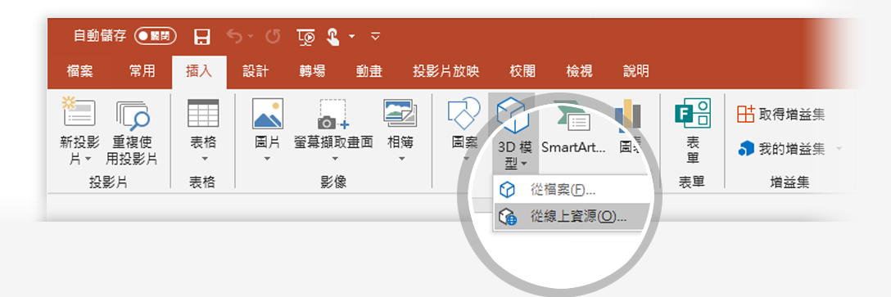
如何插入 3D 模型
若要插入 3D 模型：
在功能區移至 [插入] > [3D 模型] -或- [插入] > [3D 模型] > [從線上來源] 這會開啟線上 3D 模型視窗，您可以在這裡直接從 PowerPoint 中搜尋或瀏覽各種 3D 模型的類別。
提示：新增模型時您必須在線上。
若要搜尋關鍵字，請在視窗頂端的搜尋方塊中輸入單字或片語， 然後按 Enter。
若要插入 3D 模型，請在模型上按一下或點選 > [插入]。
3D 模型便會下載並置於您的 PowerPoint 投影片。
1
2
3

Slide 20
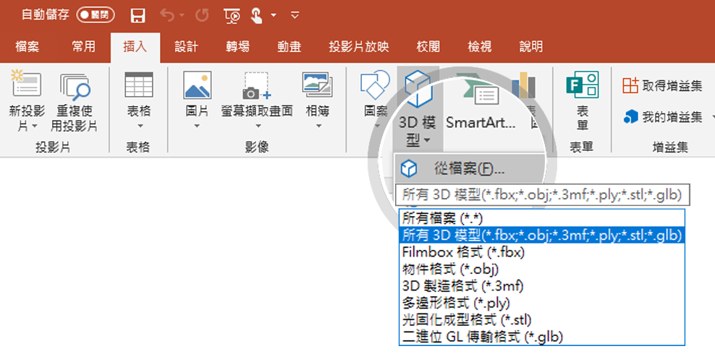
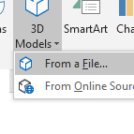
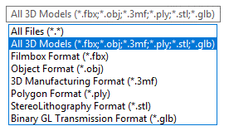
您有自己的 3D 模型嗎？您可以匯入！
PowerPoint 可讓您匯入各種熱門的 3D 模型格式。
無論您的工作流程是否在 PowerPoint 中，您都應該能夠找到適合的解決方案，讓您的 3D 模型可以隨時隨地在任何裝置存取並向任何人展示 (只要幾個快速修改)
若要插入 3D 模型：
1
移至 [插入] > [從檔案插入 3D 模型…]
這會開啟 [插入 3D 模型] 視窗，您可以在電腦、網路或雲端磁碟機搜尋任何已儲存的 3D 模型。
2
選取檔案，然後按一下 [插入]來插入 3D 模型。
3D 模型便會置於您的 PowerPoint 投影片

Slide 21
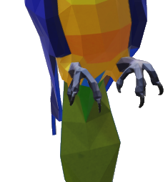
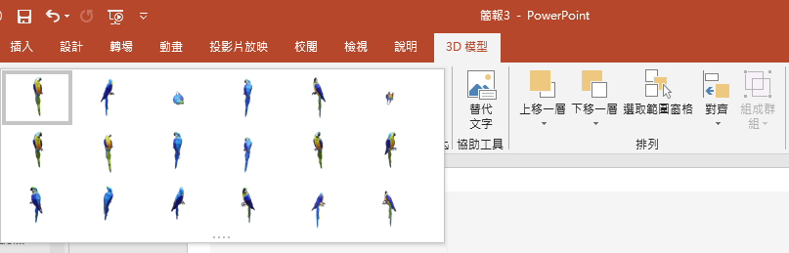
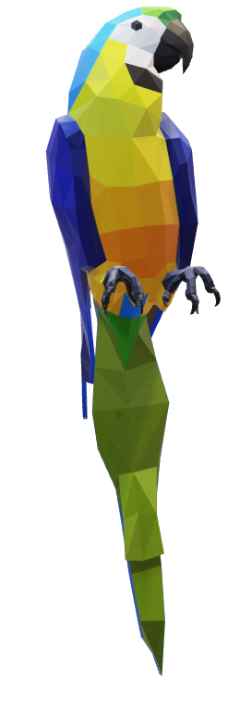
兩個放置及旋轉 3D 模型的方法
請用右邊的鸚鵡試試：
1
按一下您的 3D 模型：按住 3D 控制以向上、下、左和右旋轉或傾斜 3D 模型。
3D 控制
2
選取模型時，您也可以在功能區 [3D 模型工具] 的 [格式] 索引標籤上，按一下 [3D 模型檢視] 圖庫，以套用其中一個不同的位置檢視。

Slide 22
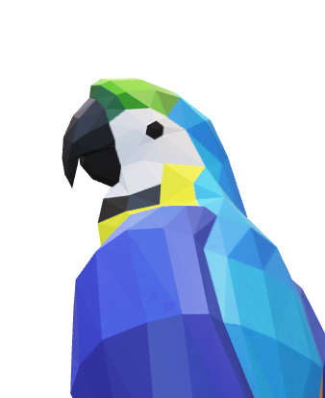
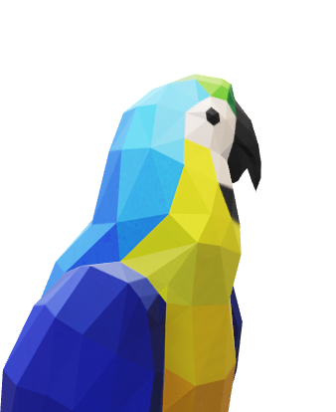
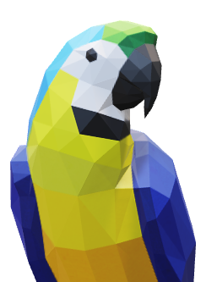
平移和縮放
若要在框架內調整大小或裁剪 3D 模型，您可以使用 [平移和縮放工具]。
1
選取 3D 模型 > [3D 模型] > [平移和縮放] 備註：[平移和縮放] 工具的作用類似於 [開/關] (切換) 開關。按下後，您會在 [平移和縮放] 按鈕周圍看到灰色方塊，表示該功能已啟用。再按一次按鈕即可停用 [平移和縮放] 功能。
2
啟用 [平移和縮放] 按鈕後，即可移動、旋轉及調整 3D 模型大小。
3
完成編輯時，請再按一下 [平移和縮放] 按鈕，以結束 [平移和縮放] 模式。

Slide 23
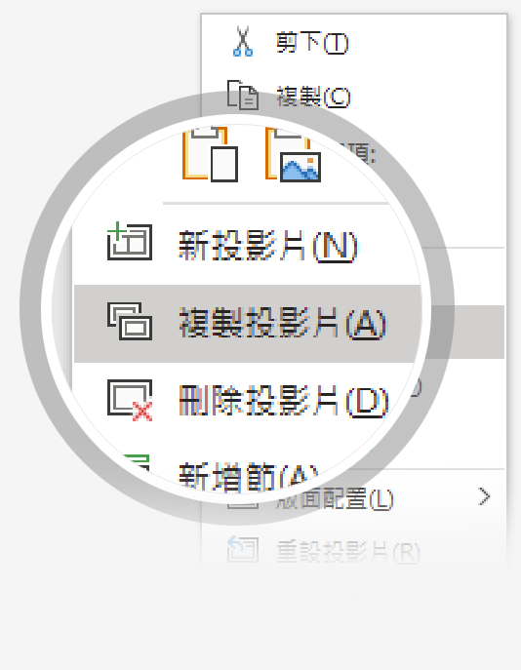
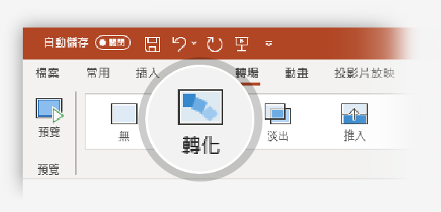

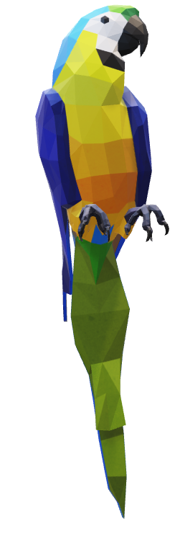
現在使用轉化轉場為 3D 模型加上動畫效果
請用右邊的鸚鵡試試：
1
複製此投影片：以滑鼠右鍵按一下投影片縮圖，然後選取 [複製投影片]。
2
在這兩張相同投影片的第二張投影片中，稍微變更右側的 3D 模型 (旋轉、移動或調整大小)，然後移至 [轉場效果] > [轉化]。
3
回到兩張投影片中的第一張投影片，然後按 [投影片放映] 按鈕，再選取 [播放] 來觀看鸚鵡的轉化效果！

Slide 24
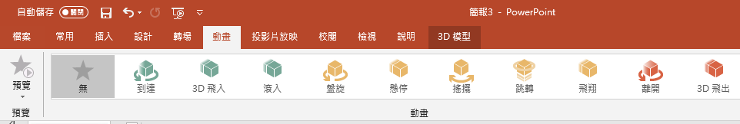
使用 [轉化] 轉場為 3D 模型加上動畫效果
請用右邊的鸚鵡試試：
1
選取右側的 3D 模型，然後移至 [動畫] > [盤旋]
提示：[效果選項] 提供您更多的 [盤旋] 選項。
2
探索專為 3D 模型設計的其他新動畫：抵達、旋轉、跳躍和轉動，然後離開。
3
按一下 [新增動畫]，將新的 3D 動畫與其他傳統的 2D 動畫 (例如淡入、放大/縮小)，或和許多 [移動路徑] 動畫中的其中一種合併，以測試及查看可能的效果。

